Slide 1
Probability & Statistical Modelling
AQ077-3-2-PSMOD and Version VD1
Summary Measures of Statistics

Slide 2
Topic & Structure of The Lesson
Introduction
Measures of Location
Measures of Position
Measures of Variation
Measures of Skewness

Slide 3
Learning Outcomes
A the end of this topic, You should be able to:
Have refreshed your knowledge of statistics on
Mean
Standard Deviation and the variance
Interpret the output from a statistical package

Slide 4
Key Terms You Must Be Able To Use
If you have mastered this topic, you should be able to use the following terms correctly in your assignments and exams:
Measures of central tendency
Measures of location
Measures of variation
Measures of skewness

Slide 5
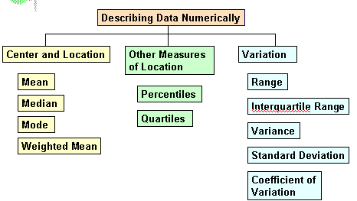
Summary Measures

Slide 6
Characteristics of Distribution
Measures of central tendency – average (the typical size)
Mean
Median
Mode

Slide 7
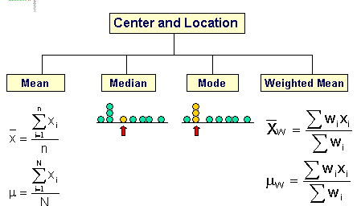
Measures of Central Tendency

Slide 8
Mean
It is the arithmetic average of data values and usually denoted by
For a set of values
mean,
For a simple frequency distribution,
mean ,

Slide 9
For grouped frequency, it is impossible to find the total values of the items, which means, in effect that, it is impossible to calculate the mean exactly. However, it is possible to estimate it.
mean,
where x = class mid-point

Slide 10
Advantages
it is widely understood
the value of every item is included in the computation of the mean.
it is well suited to further statistical analysis.
Disadvantages
its value may not correspond to any actual value.

Slide 11
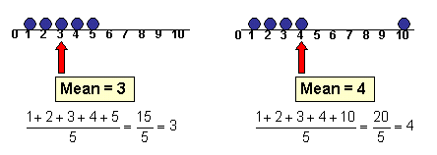
it might be distorted by extremely high or low values.

Slide 12
Quick Review Question
Example:
Consider the following set of sample data and compute the mean.
(a) 17, 15, 18, 20, 15, 15, 11, 15
(b)
(c)
x | 1 | 2 | 3 | 4 | 5 | 6 | 7
f | 3 | 4 | 7 | 12 | 12 | 7 | 5
Range | 0 – 5 | 5 – 10 | 10 – 15 | 15 – 20 | 20 – 25 | 25 – 30
f | 2 | 12 | 15 | 18 | 13 | 10

Slide 13
Consider the following data:
7, 7, 7, 7, 7
4, 6, 6.5, 7.2, 11.3
-193, -46, 28, 69, 177
Find mean for each set of data above.

Slide 14
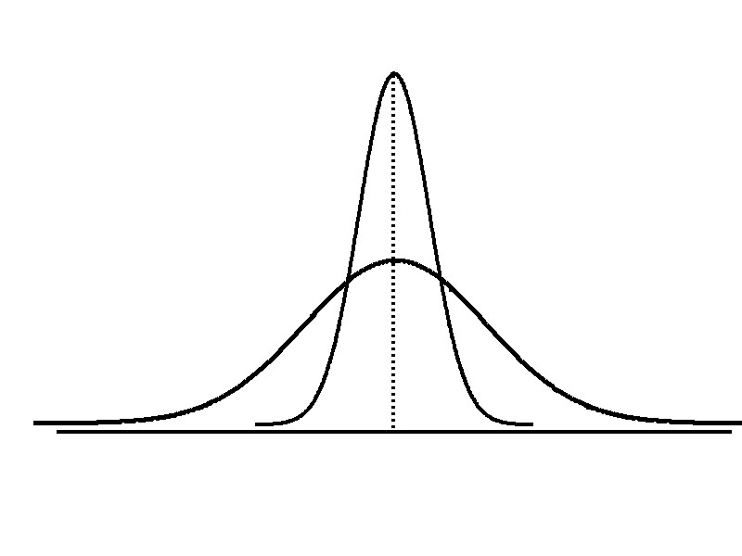
Measures of Dispersion (Variation)
A measure of the degree or dispersion of data
Range
Standard deviation
Variance
Quartile deviation
Mean deviation
Needed for two basic purposes.
To asses the reliability of the average of the data
To serve as a basis for control of the variability

Slide 15
Standard deviation
it is a measure of the extent to which data for a particular random variable (x) is spread about the mean.
The higher the standard deviation the greater the amount of scatter.

Slide 16
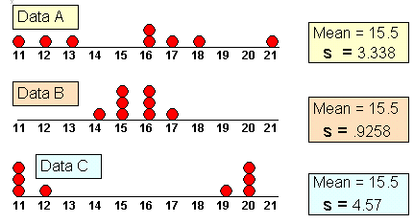
Comparing Standard Deviation

Slide 17
standard deviation for a set of values is calculated as follows:
For population

Slide 18
For sample

Slide 19
Standard deviation for simple frequency distribution
For sample:
For Population:
where x = class mid-point

Slide 20
Standard deviation for grouped frequency distribution
For sample:
For Population:
where x = class mid-point

Slide 21
Another formulation which is convenient when a calculator is being used is as follows:

Slide 22
Advantages
it takes all values into account, therefore it can be regarded as truly representative of the data.
it is suitable for further statistical analysis.
Disadvantages
it is more difficult to understand than some other measures of dispersion.

Slide 23
Quick Review Question
Example:
(a) Find the standard deviation for the following data:
196, 198, 198, 199, 200, 200, 201, 201, 202, 205
(b) The time taken for 115 candidates to complete an intelligence test was recorded and summarise in the table below.
Calculate estimate of the mean and standard deviation of the time taken to complete the test.
Time (minutes) | 0 - 1 | 1 - 2 | 2 - 3 | 3 - 5 | 5 - 10
Frequency | 10 | 15 | 25 | 40 | 25

Slide 24
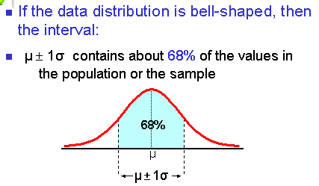
The Empirical Rule

Slide 25
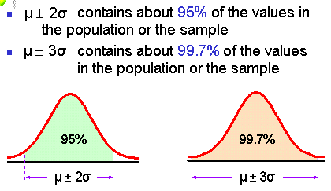

Slide 26
Variance
it is a measure of the extent to which values in a data set vary around the mean.
if most values cluster closely around the mean, the variance will be a small figure.
if, however, most values are widely dispersed around the mean, the variance will be a large figure.
variance = (standard deviation)²

Slide 27

Proportion
A proportion is a name we give to a statement that two ratios are equal. It can be written in two ways:
two equal fractions,
or,
using a colon, a:b = c:d

Slide 28
EXCEL
=AVERAGE(number1, number2,…)
=MEDIAN(number1, number2, ...)
=MODE(number1, number2,…)
=QUARTILE(range, 1)
=QUARTILE(range, 3)
=STDEV(number1, number2,…)

Slide 29
Summary of Main Teaching Points
Measures of statistics:
Location
Position
Variation
Skewness

Slide 30
Question and Answer Session
Q & A

Slide 31
What we will cover next
Correlation & Regression Analysis

